Slide 1
Doing Science
The Washington Way

Slide 2
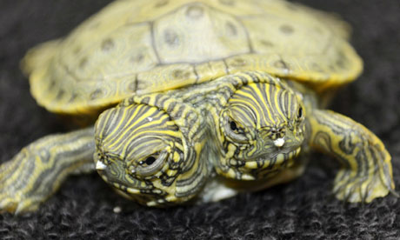
What?????

Slide 3
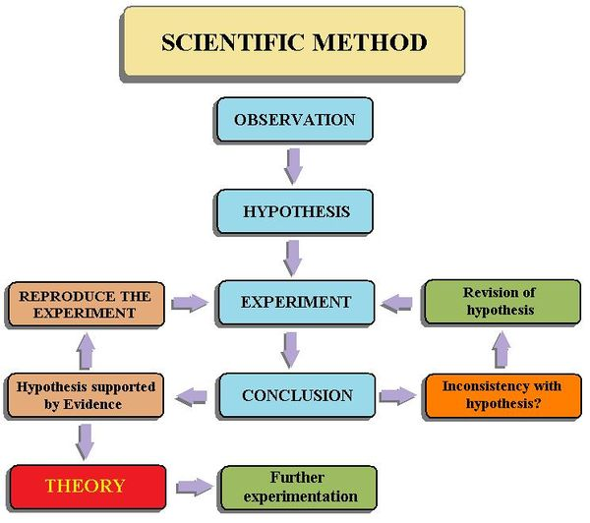
Question/Observation
Others redo if hypothesis is supported
Revise if hypothesis is not supported

Slide 4
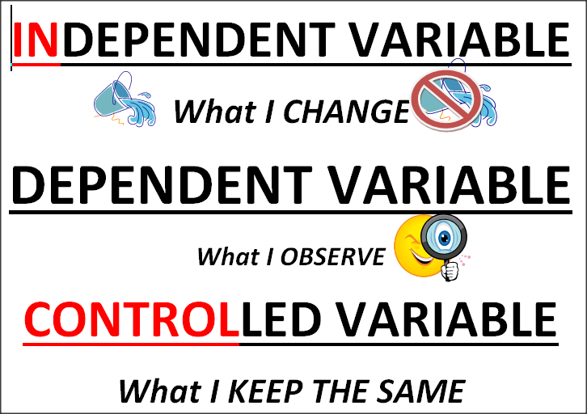
What I observe or measure

Slide 5
Practice: What are the variables?
A student wondered if eating spinach would make your muscles grow bigger.
IV:
DV:
CV:

Slide 6
What is a testable (research) question?
A question that can be answered by hands-on experiments.
Hint: How does _________ affect _________?
- you can put the dependent variable and independent variable in the blank.

Slide 7
Practice
A student wanted to know about plants a light from the sun.
Write a testable question:

Slide 8
Hypothesis
An educated guess
If (I do this) then (this will happen) because_______________________________.

Slide 9
Practice
How does the amount of light affect how tall a plant grows?
Write a hypothesis:

Slide 10
Experiment
Design an experiment with a materials list and procedure (directions)
1. Get materials
2. Label the test tubes 1-4
3. ………….

Slide 11
Conclusion
CEE:
Claim: One sentence that states the answer to your testable question – uses the data.
Evidence: 2 to 3 pieces (using the numbers or observations from your experiment) that support the claim.
Explanation: Use your science knowledge to explain why the data looks the way it does.

Slide 12
Work time
Work as a group to complete the worksheet
One assignment will be collected from the group. This is the entire groups grade.

