Slide 1
Protist Population Growth Lab
The Gause Principle

Slide 2
Do a search …
Virtual protist population lab
Or
http://www.mhhe.com/biosci/genbio/virtual_labs_2K8/labs/BL_19/

Slide 3
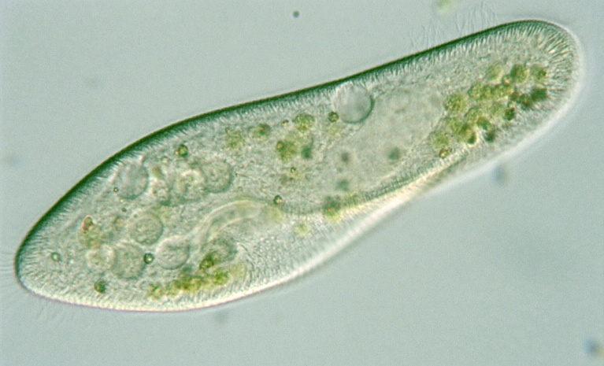
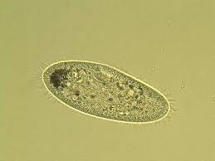
Paramecium: A ciliated protist
Freshwater
Many varied species
Parameciem caudatum
Paramecium aurelia

Slide 4
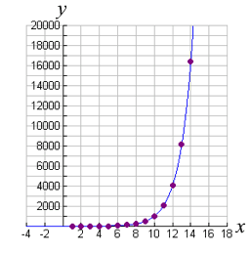
Given time and unlimited resources……..
Exponential Growth

Slide 5
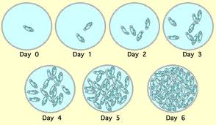
But……..
Limiting factors affect population growth
Food
Water
Shelter
Space
competition

Slide 6
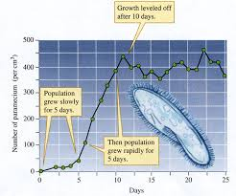
Carrying Capacity
The maximum and stable population that an environment can sustain

Slide 7
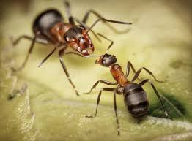
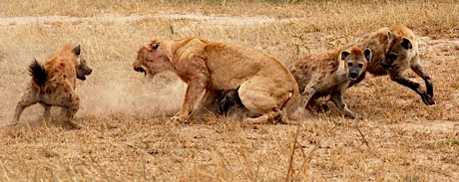
Competition
Intraspecies: within a species
Interspecies: within two or more species

Slide 8
Principle of Competitive Exclusion
When two species compete for resources the one with the greatest growth rate will outcompete the other.
No two species can occupy the same niche

