Slide 1
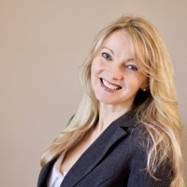
Introduction to Small Business
Sign up to learn about how to start a small business in Minnesota.
Learn the skills you need to be successful running your own business.
Requirements: ELL B2+ and eligible to work in US.
Register Now!
Days: Monday -Thursday
Time: 8:30 – 10:30 in person
Dates: April 15 – June 13
You will learn…
Meet the
Teacher!
Business planning
North Star Certificated
Lia Olson
Customer service & communication skills
$
Budgeting skills
Teacher Lia is one of our most experienced teachers. She has a Ph.D. in education and is author of numerous textbooks. She wrote curriculum for the small business class and has taught it many times.
Marketing
Interview Skills
SIGN UP TODAY!
Talk to an advisor in the office, call
651-290-4822 or register online (spps.org/hubbs)

