Slide 1
FY2021-22 Priority Based Budget School Community Meeting
May 2021
Notes:
1

Slide 2
Our Mission
Inspire students
to think critically, pursue their dreams and change the world.

Slide 3
Budget Process
We committed to an ongoing, priority-based budget process for the 2021-22 budget
July-Sept 2020 |  | Sept-March |  | March-April |  | April-June |  | June 2021 ->
1. Plan and Prepare |  | 2. Set Instructional Priorities |  | 3. Pay for Priorities |  | 4. Implement Plan |  | 5. Ensure Sustainability
$
Notes:
Overview of the Process
These are the steps we’re taking this year. As you can see, we started planning for next year’s budget back in July.

Slide 4
Video: School District Budgeting
Notes:
Video
This video explains our major sources of money, and some of the rules. It’s less than three minutes long, but explains a lot of things. Let’s watch it together.

Slide 5
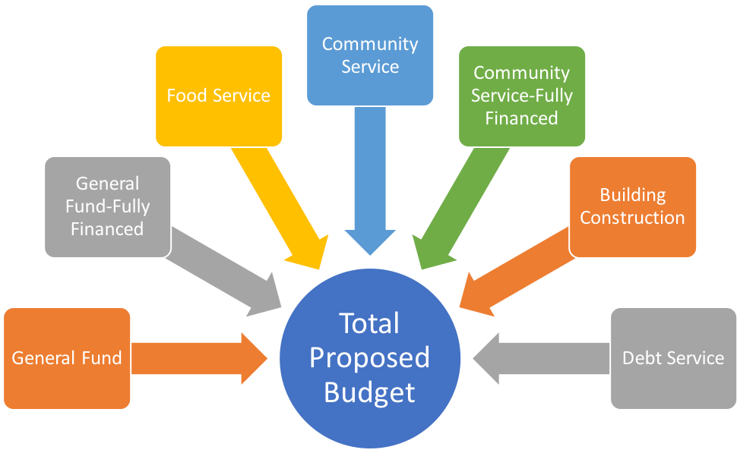
Total Budget or General Fund?
Estimated 2021-2022 General Fund Budget
=
$570,560,000
Notes:
In FY21, the totals in each were (in millions):
General Fund $582.8
General Fund Fully Financed $49.4
Food Service $46.1
Community Service $22.8
Community Service Fully Financed $5.5
Building Construction $50.5
Debt Service $65.2
Total Budget $822.3

Slide 6
1. Plan and Prepare
Estimate 2021-22 Revenue – General Fund
General Fund Revenue | 2020-21 Adopted | 2021-22 Projected | Difference
Total | $582,778,000 | $570,560,000 | $(12,218,000)
SPPS is projecting a decrease in General Fund state revenue next year due to a projected student enrollment decrease for next fall.

Slide 7
2. Set Intructional Priorities
Confirm Instructional & Operational Priorities
SPPS Achieves
Systemic Equity
Positive School and District Culture
Effective and Culturally Responsive Instruction
College and Career Paths
COVID-19
Maintaining district services and support for students, families & staff
Focus on learning loss
Continuation of learning model flexibility and adjustments
Notes:
These are the FY22 Instructional and Operational priorities

Slide 8
2. Set Instructional Priorities
Criteria for Schools & Programs
Example: School Staffing
Based on Enrollment | Based on Programming and Student Needs
Classroom Teachers | MLL Teachers
A guide to all school positions was provided to principals when they received their budgets. It’s also available online at spps.org/budget.

Slide 9
$
3. Pay for Priorities
Estimate Costs – General Fund
General Fund Investments | FY2020-21 Adopted Budget | FY2021-22 Projected Budget*
Individual Schools | $253,051,000 | $256,320,000
School Support Services | 208,820,000 | 214,335,000
District-wide Support | 116,780,000 | 117,914,000
Administration | 4,127,000 | 4,227,000
Total | $582,778,000 | $592,796,000
If we “bought” everything next year that we “bought” this year, we couldn’t afford it
*The FY2021-22 projected amounts are adjusted for inflation and changes in enrollment

Slide 10
$
3. Pay for Priorities
Analyze Savings Options – General Fund
These are proposed investment reductions in the General Fund:
Proposed General Fund Reductions | Amount
Individual Schools | $(410,000)
School Support Services | (842,000)
SPPS Achieves | (100,000)
Total Savings | $(1,352,000)
Notes:
These are reductions to the Districts budget for next year

Slide 11
$
3. Pay for Priorities
Analyze Savings Options – General Fund
Realignment of existing investments to ESSER II & GEER I funding sources to support district stabilization and continuity of operations in schools & programs, including departments that directly support COVID-19
Realign Existing Investments to ESSER II/GEER I in FY22 FTEs | Amount
Individual Schools (71.40) | $(8,703,000)
School Support Services (13.17) | (8,619,000)
District-wide Support (45.75) | (8,255,000)
Administration 0.00 | (175,000)
SPPS Achieves (1.50) | (125,000)
Total Savings (131.82) | $(25,877,000)
Note: ESSER II funds expire in September 2023 and require federal accountability & reporting requirements
The amount listed includes salary and non-salary items and is not directly related to the FTEs alone.
Notes:
We are using federal funds to help support our schools & programs. The amount listed includes salary and non-salary items and is not directly related to the FTEs alone.

Slide 12
$
3. Pay for Priorities
Prioritize Investments to Sustain or Increase
Strategic Plan Priorities |  | Other Priorities Include
Sustain | Increase | Sustain | Increase
PBIS/SEL support Middle School Model Stakeholder engagement New teacher support and mentoring | Systemic Equity Access to a well-rounded education Effective & Culturally Responsive Instruction College and career paths development and support Personal Learning Plans, Career Curriculum | School & Program staffing and other resources to sustain continuity of operations during COVID-19 Variety of school program options Athletics and other after school programming | School & Program staffing and other resources to support additional learning options for students due to COVID-19 (ie: add’l programming, tutors) Lunch accounts Safe and secure learning environments Technology infrastructure
*Total new investments = $3,956,000
Notes:
These are some of the areas that were prioritized in the FY22 budget. There are many more in the School Allocation Guidelines

Slide 13
$
3. Pay for Priorities
Prioritize New Investments – General Fund
General Fund Investments (new in FY22) | Amount
Individual Schools | $150,000
School Support Services | $2,412,000
District-wide Support | $586,000
Administration | $213,000
SPPS Achieves | $816,000
Other (directly related to funding sources, i.e.: levy) | $816,000
Total | $4,993,000
Notes:
This is a summary of new investments that we made for FY22 in the General Fund

Slide 14
4. Implement Plan
Proposed Balanced Budget – General Fund
General Fund Investments | FY2020-21 Adopted Budget | FY2021-22 Proposed Budget*
Individual Schools | $253,100,000 | $247,357,000
School Support Services | 208,820,000 | 209,375,000
District-wide Support | 116,780,000 | 109,586,000
Administration | 4,127,000 | 4,242,000
Total | $582,778,000 | $570,560,000
Note: as of 4/10/21 – subject to change
Notes:
This is the FY22 Proposed balanced budget at $570,560,000.

Slide 15
4. Implement Plan
FY22 School and Program Budget Allocation Timeline
Week of April 26 | Schools receive budget allocations Programs receive budget allocations Online Budget Fair
April 26 – May 14 | School level budget decisions/planning meetings
May 14 | School and program staffing decisions due to Human Resources School and program budgets due to Finance
May-June | School budget information shared with families, community, staff
June 22 | BOE Meeting: Final FY22 Budget presented to BOE for approval
Notes:
This is the FY22 Budget Timeline

Slide 16
4. Implement Plan
**School Information**
Notes:
Add your school budget information here

Slide 17
5. Ensure Sustainability
Put Strategies into Practice and Evaluate Results
Improve resource allocations through:
Assessing program effectiveness
Aligning resources with priorities
Presenting a multi-year financial plan

Slide 18
Feedback
What works well about the plan for next year?
What do you disagree with?
Examples:
“I’m glad to see an increase for middle school”
“It’s good that there will be more custodians.”
Feedback will be shared with administration and the Board of Education, to be used as they develop and approve budgets
Notes:
Discussion and Feedback
Now that you have this background, let’s talk about this draft budget. We have some questions for you, and I’ll be taking notes from our discussion. Notes from all our meetings will be shared with administration and Board members.
Discussion Questions and Prompts
What works well about the plan for next year?
What topics or words are important to you?
What do you want to be certain remains in place if the budget is adjusted moving forward?
What do you disagree with?

