Slide 1
Macromolecule Testing
Agenda:
Announcements
Latin and Greek Quiz
Test Review
Macromolecule Testing Lab
Word of the day:
Positive Test:
A reaction (or color change) that shows that a substance is present.

Slide 2
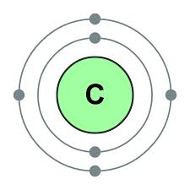
Life on earth is carbon based.
Carbon is an element

Slide 3
The Carbon Molecule
Important to all the macromolecules that make up the cell
Give us energy
Repair cells
Make up the cell membrane
Help in cell communication
And many more

Slide 4
The macromolecules of life
Proteins
Lipids
Carbohydrate
Sugars (monosaccharides)
Starches (polysaccharides)
Nucleic Acids

Slide 5
We do not test for Nucleic Acids
All living things have nucleic acid (genetic materials).

Slide 6
Data Chart #1
Macromolecule | Indicator Solution | Positive Test
Carbohydrate: monosaccharide
Carbohydrate: Polysaccharide
Protein
Lipid

Slide 7
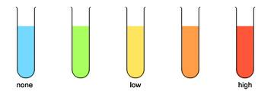
Testing for Macromolecules
Carbohydrates (monosaccharide)
Use Benedicts Solution
Instructions:
Add a small sample of carbohydrate (monosccharide) to a test tube
Add 20 drops of Benedicts solution
Heat in hot water bath for three minutes
Record color

Slide 8
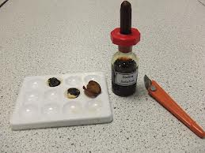
Testing for Macromolecules
Carbohydrates (polysaccharide)
Use Iodine
Instructions:
Add a small sample of carbohydrate (polysaccharide) to a well plate
Add 2 drops of Iodine solution
Record color

Slide 9
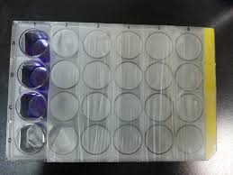
Testing for Macromolecules
Proteins
Use Biuret Solution
Instructions:
Add a small sample of protein to a well plate
Add 10 drops of biuret solution
Record color

Slide 10
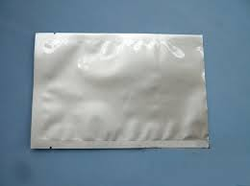
Testing for Macromolecules
Lipids
Use Sudan 3 powder
Instructions:
Put a small amount of sample on a piece of aluminum foil
Get sudan 3 powder from teacher
Stir powder into sample
Soluble: lipid
Non soluble – not a lipid

Slide 11
Data Chart #2
 | Mono | Poly | Protein | Lipid
Unknown 1
Unknown 2
Unknown 3

Slide 12
Test for Unknowns
Get the unknowns from your teacher
Perform each macromolecule test to determine what is present in the unknown
Hints
Use your known data charts to determine the unknown

