Slide 1
Saint Paul Public Schools
Community Education
Living/Working Well
With Persistent Uncertainty
Ted Bowman
tedbowman71@gmail.com

Slide 3
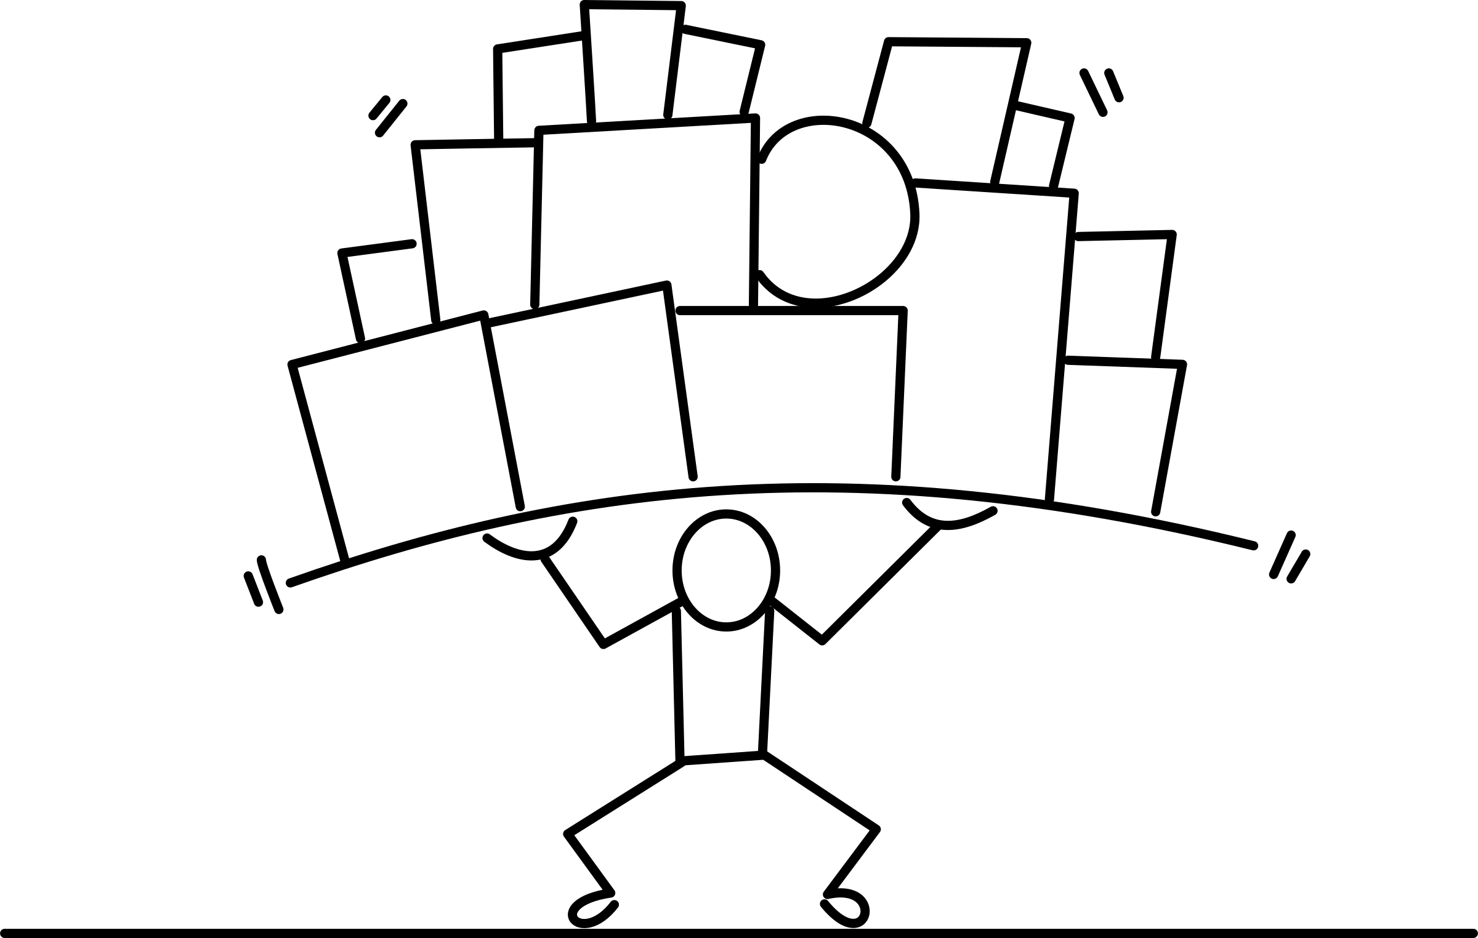
Because it is in PowerPoint DOES NOT mean it is true, the best, should be believed OR practiced.
Please participate in this session with informed skepticism

Slide 4
Assumptive Worlds
All of us from the moment of our birth, have been
building inside ourselves a model of the world, a set
of assumptions on the basis of which we recognize
the world that we meet and plan our behaviour
accordingly. Because this model is based on reality
it is, most of the time, a valid and useful basis for
thought and behaviour. We rely on the accuracy of
these assumptions to maintain our orientation in the
world and to control our lives. Anything which
challenges this model incapacitates us.
C.M.PARKES

Slide 5
Perspectives to Consider (Assumptive Worlds?)
A pre-critical naivete is common for children…accepting stories from influential adults as if true is widespread.
(If adults don’t talk, children’s imagination can take them to a darker place)
Post-critical naivete is the ability and the skills to question accounts and stories in personal, workplace and civic situations

Slide 6
Perspectives to Consider
We have always done it that way
That is not the St. Paul Public Schools way
Fit in – don’t stand out
Assimilation for new employees as a goal
Don’t make waves
NOT in staff meetings
Raising questions is not encouraged
CAN BE SIGNS OF PRE-CRITICAL NAIVETE!!

Slide 7
The Guest House
This being human is a guesthouse.
Every morning is new arrival.
A joy, a depression, a meanness,
some momentary awareness comes
as an unexpected visitor.
Welcome and entertain them all!
Beginning lines of a poem by Rumi

Slide 8
Is A Time When
Predictability Breaks Down
Our Predictable Ways
Of Thinking About And Doing Things
Are Interrupted By Change
Change Results
In Uncertainty

Slide 9
Change Management
Lewin’s model
unfreezing → changing → refreezing
Adaptation
action → movement→ momentum

Slide 10
Transference
The Reliving Of Past Or Current Interpersonal Relationships or Experiences
IN CURRENT SITUATIONS
A tool that allows one to bring material from the past into conscious awareness
A way to work through issues so that they are not repeated in destructive ways. Common Definition
A way to acknowledge your stories and seek re-storying that promotes healing.
Additional definition by Ted Bowman

Slide 12
Ambiguous Loss
Losses/Changes that
are:
unclear, confusing, and for which
future stories / outcomes are unknown
Etymology: “driven in both ways” Boss

Slide 13
Ambiguity occurs when there are…
Unanswered questions, uncertainty and the disruption of family and work life due to Covid19
“What is distressing us is not just the virus, but the ambiguity surrounding it, what it will do, and what we should do about it. Science provides some answers, but we are experiencing uncertainty, and that’s very stressful for a society that is accustomed to solving problems and having definitive answers.”
Pauline Boss

Slide 14
Therefore:
Workers will routinely experience tensions as they consider their publics. That can lead to:
ambivalence diplomacy
ambiguity perspective
regret guilt
flashbacks/history context
second guessing conflicts
the need for an internal compass

Slide 15
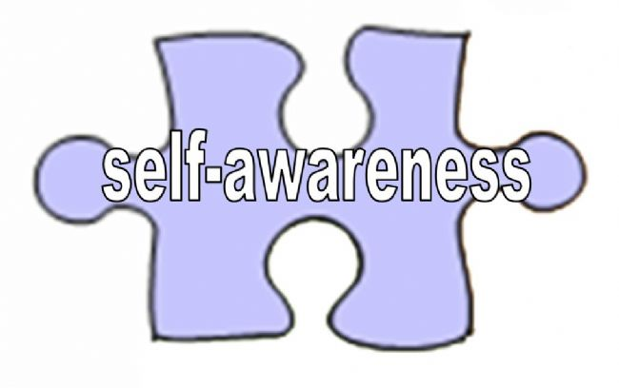
Essentially, the only instrument we bring to
workplace interactions is ourselves. Hence, the
more self aware we are the more present we can
be in the exchanges with colleagues and students.
Paraphrased from comments by Virginia Satir

Slide 16
Holding On and Letting Go A Time for Discernment
Naming the present realities
Receiving how others are experiencing their realities
Laying aside some expectations
Embrace the experience of some vacillating
Rehearsing values
Making promises about how we treat ourselves and others
Adapted from work of Susan Nienaber

Slide 17
Be Grateful for What Has Been
Be Loose With What Is
Be Generous With What Will Be
I am only one. But still I am one.
I cannot do everything,
But still I can do something.
And because I cannot do everything,
I will not refuse to do the something that I can do. Edward Hale

Slide 18
Possible Ground Rules
I will tell my story and let others tell theirs
I avoid “awfulizing” negative experiences
I say what needs to be said to the one who needs to hear it
I devote at least as much energy to careful listening as to careful speaking
If something prompts anger in me, I will report it honestly in a way that invites positive solutions
I refrain from blaming and shaming

Slide 19
Changes in Organizational Processes
Strategic planning as practiced in the past has been rejected because of fast-changing realities – outdated in six months to 2 years
Replaced by guiding principles that will inform decisions no matter the situation

Slide 21
Three Principles
If Something Is Unmentionable, It Is Also Unmanageable
Folk Wisdom
Not Everything That Is Faced Can Be Changed, But Nothing Can Be Changed Until It Is Faced
James Baldwin
Do not be daunted by the enormity of the world’s grief. Do justly, now. Love mercy, now. Walk humbly, now. You are not obligated to complete the work, but neither are you free to abandon it.
from the Talmud

Slide 23
Be Able to Laugh at Yourself Practice Humility at Times

Slide 24
More Principles/Practices
Understanding is more important than agreement
The direction in which you look will determine what you see
HOW things are handled is often as or more important than WHAT happens

Slide 25
BE A CHANGE AGENT (Proactive Not Just Reactive)
Be Aware Of Your Attitude
Be Tolerant Of Self And Others
Keep A Balance In Your Life:
Job, Interests, Family, Volunteerism
Allow For Stress And Discomfort
Manage Your Stress; Be Attentive To Others
Pace Yourself
Maintain Stability

Slide 26
Assertion
Two or more perspectives often enrich choices and can build cohesion
Conflict is common, inevitable, and can be seen as a compliment
It can be more dis-respectful to avoid than to engage creatively in a conflict
Conflicts are often with oneself, with one’s past and culture, with values, and with one or more persons or systems

Slide 27
Cultivate Your Internal Supervisor
What does this mean to you?
What practices do you utilize so that others get your best self, not your distracted self?
How easy is it for you to ask for help?
Can you be at ease with some ambiguity?
Do you truly know your “red flags”?
What are some of your methods for dealing with momentary distress and anxiety?

Slide 28
Responses When Stressed
Attempt to be as present as possible
Resist escaping to “robo” responses
Linger a little longer in not knowing
Move from explanation to exploration
Ask questions, clarify, before acting
Recognize your own reactive tendencies
Distinguish creative competencies to reactive tendencies

Slide 29
Mental Health Tips for Pandemic Times (Uncertain)
Acknowledge your anxiety
Schedule worrying
Reframe the situation
Set quarantine rituals
Get moving
Small acts of altruism
Physical, not social distancing
What else?

Slide 30
Resiliency/ Hardiness
The capacity to spring back, rebound, and successfully adapt to adversity – Bowman from many sources
The capacity to spring forward…
Resilience arises from ordinary resources and processes Masten
The ability to connect, reconnect, and resist disconnection in response to hardships, adversities

Slide 31
Examples of Resiliency
Accepted What They Could Not Change, Changed What They Could
Manageable Pieces/Steps
Realized: Bad Things Happen To Good People
Used Creativity
Healed Themselves By Helping Others
Did Not Allow Bitterness To Consume / Define Them
Hopeful Visions Of Future
Drew On Spiritual Resources

Slide 32
Factors that Sustain Resiliency
Joy in participating in others’ growth
Feeling successful in helping others
Closely observing human life and meaningful human contact
Finely tuned professional boundaries
Supervisor support
Sense of humor and playfulness
Constant focus on professional development and avoidance of stagnation
Tolerance of some ambiguous professional loss and normative failure
Basic needs are met
From The Resilient Practitioner

Slide 33
Dual-processing model (Stroebe and Schut 2001)
Loss/Stress Orientation
Stress/Grief work
Intrusion of grief
Denial
Sorting, choices
Autonomy
Restoration Orientation
Attending to life changes
Doing new things
Distraction, denial, avoidance of grief
New roles, identities, relationships
Notes:
Health warning
Margaret Stroebe and Henk Schut have also studied hundreds of bereaved adults and noticed that (-click-) although lots of them do spend all of their time “mourning” and being sad which can really get in the way of getting on with things, lots of them also actually invest lots of time “getting on with stuff” (-click-)
And they suggested that bereaved people alternate between these two ways of being (-click-)
This is very normal (although if you’re switching as quickly as this, then that could be problematic!)
The great thing about this is that if someone is in the Loss Orientation phase and are fed up with feeling wretched, then it can be very re-assuring to talk to them about how lots of people also experience the restoration orientation. Similarly if someone is busy getting on with stuff, we can sort of warn them that lots of people do that and then suddenly feel the pain – that way if and when it happens at least they were expecting and realise that it’s normal and not weird.

Slide 34
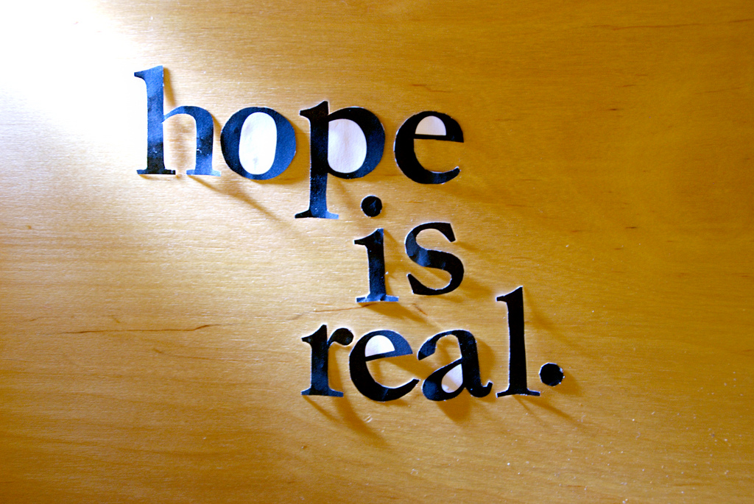
Hope
Definitions usually include:
EXPECTATION
DESIRE
Which can involve GOALS, ATTRIBUTES,
REDEFINITION, MEANING,
PEACE, ENERGY

Slide 35
Reasonable Hope
Reasonable hope is relational
Reasonable hope is a practice
Reasonable hope maintains that the future is open, uncertain, and influenceable
Reasonable hope seeks goals and pathways to them
Reasonable hope accommodates doubt, contradictions, and despair Weingarten
Notes:
160 minutes into session, including the midway break – group discussion if possible, if not one last pair and share

