Slide 1
Small Businesses

Slide 2
Landscaping – plant trees, gardens

Slide 3
Childcare – take care of kids

Slide 4
Catering – cook, deliver food

Slide 5
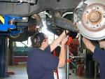
Auto repair – fix cars

Slide 6
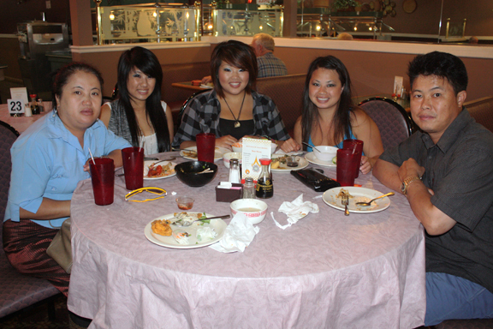
Restaurant – cook, serve food

Slide 7
Barber shop – cut hair

Slide 8
Beauty salon – fix hair, nails

Slide 9
Pet Care – take care of animals

Slide 10
Clothing Shop – sell clothing

Slide 11
Tailor / Seamstress – sew clothing

Slide 12
Cleaning service – clean houses

Slide 13
Personal Care Attendant Company – take care of sick people at home

Slide 14
What other small business ideas do you have?

